Slide 1
Lead Conversion Score Prediction
-By Nirmal

Slide 2
PROBLEM STATEMENT OVERVIEW
Predicting the customers that would show more intent towards a recommended credit card

Slide 3
Problem Statement Overview
The bank has identified a set of customers that are eligible for taking credit cards
Customer details like gender, age, region etc. and their details of his/her relationship with the bank are also available
DATASET

Slide 4
Problem Statement Overview
Below customers are more interested in buying the credit card:
Male members
customers living in Urban region
customers with salaried Jobs
customers with existing credit products
customers that are active
customers with less age number
customers with higher Vintage
customers with higher bank balance
HYPOTHESIS – INTENT TOWARDS THE CREDIT CARD

Slide 5
EDA – UNIVARIATE ANALYSIS
The customers are of 23-85 years of age
45% are Females and 55% are Males
Through X1, 42.20% of customers are acquired
Through X3, 27.96%o of customers are acquired
Through X2, 27.56% of customers are acquired
Through X4, 02.26% of customers are acquired
33 % of customers had Credit Products
38 % of customers are Active in last 3 Months
Entrepreneurs are only 1% of customers
Half of them are self employed followed by salaried and others

Slide 6
DATASET CORRECTION
Issue :
The data for region code have zero values mostly which results in sparse matrix
Action:
Hence we are creating a new column "Region_Code_others“ for non significant Region Codes

Slide 7
EDA – BIVARIATE ANALYSIS
Positive Correlation
Age and Vintage
Vintage and account balance
Age and account balance
Age and credit card
Vintage and credit card
Account balance and credit card

Slide 8
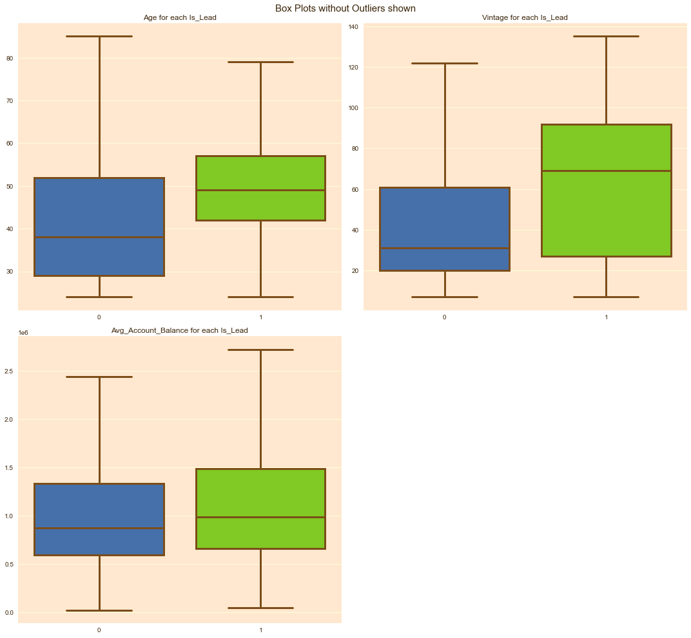
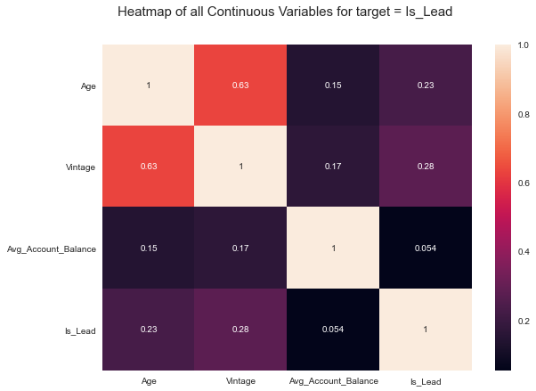
I N S I G H T S

Slide 9
EDA – BIVARIATE ANALYSIS
customers that are more interested in credit cards:
Male members
Entrepreneurs >Self Employed>Salaried
X3>X2>X1 [X3,X2,X1 are channel codes]
Members having existing credit products
Members that are active in past 3 months
Senior age groups are more interested than younger age groups

Slide 10
EDA – BIVARIATE ANALYSIS
Positive Correlation between other variables and credit product:
Is_Lead
Gender (Male)
Occupation (Entrepreneurs>Salaried>Others)
Channel Code
Active customers

Slide 11
EDA – Multivariate Analysis
Entrepreneurs who are interested on credit product does not affect gender
Salaried from 40-80 age are looking for credit card irrespective of gender
Entrepreneurs from 20-60 age are looking for credit card irrespective of gender
Entrepreneurs of age range 20-60, Others of age 40-60 and salaried of age 60-80 shows more credit card interest

Slide 12
EDA – Multivariate Analysis
Channel_Code - X1, mean age of Lead customers are higher than non-lead customers.
Mean age of Lead customers are higher than non-lead customers for active members

Slide 13
PREDICTION MODEL
I created an XGBClassifier model with parameters,
{learning_rate =0.1,
n_estimators=100,
max_depth=5,
min_child_weight=1,
gamma=0.15,
subsample=0.8,
colsample_bytree=0.8,
objective= 'binary:logistic',
nthread=4,
scale_pos_weight=1,
seed=101} which give a Roc_Auc score of 0.8715286129

Slide 14
CONCLUSION
Age have a role on Creditcard interest.
As age increase, CreditcardInterest also increase.
Those customers with high 'Vinate_Age_ratio' will have more chance of conversion
Customers who had availed earlier Credit_Products and those customers who are reluctant to answer had more chance for Lead conversion
Saalaried and Other occupation has more chance for leadConversion

Slide 15
Thankyou!!! Nirmal Tom

